Slide 1
Differential Item Functioning
Derek Briggs
Psychometric Modeling

Slide 2
Outline
Test Fairness and DIF
Non-IRT DIF Approach: Mantel-Haenszel
IRT-Based Approach
Homework Activity

Slide 3
Test Fairness and DIF

Slide 4
Are Standardized Tests Biased?
Fair education reform advocates have long cited a litany of concerns about standardized testing, many of which address racial bias and discrimination, as author and researcher Harold Berlak explains in the journal Rethinking Education:
“Standardized testing perpetuates institutionalized racism and contributes to the achievement gap between whites and minorities. For instance, the deeply embedded stereotype that African Americans perform poorly on standardized tests hinders many African Americans' testing ability. Also, research has shown that minorities statistically have lower standardized test scores than whites because of existing, hidden biases in the development and administration of standardized tests and interpretation of their scores. Therefore, the achievement gap will not begin to close until current standards and assessment tests are significantly reformed.”
From http://www.huffingtonpost.com/ronnie-reese/test-bias-minorities_b_2734149.html, February 21, 2013

Slide 5
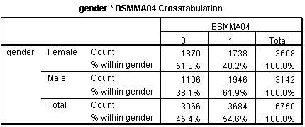
Illustrative Context
6,750 students took 6 TIMMS items.
Consider MC Item 4 (BSMMA04)
On this item 1 = correct response, 0 = incorrect
62% of males get it correct vs. 48% of females
Is the item biased against females?

Slide 6
Impact vs DIF
Impact
Students in group 1 tend to do better on an item than students in group 2.
DIF
After controlling for the ability believed to be necessary to solve an item, students in group 1 still tend to do better than students in group 2.

Slide 7
Bias vs Impact
Bias: a systematic difference between two quantities that should be equal (Camilli, 2006)
Impact: an observed difference in average performance between two groups.
Possible explanations for impact
True differences in the ability being measured
Inclusion of test items that measure an unintended dimension that favors one group over the other
Construct-irrelevant source such as differnces in test administration conditions that favors one group over the other
Only 2 and 3 would be considered “biases” that could be solved by changing the design of the test.

Slide 8
Test Bias
What we want to know is this:
Is the test fair? Or is it biased against certain student groups?
Evidence of differential item functioning is a necessary but not sufficient condition to conclude that a test is biased.
It is also possible for a test to be considered unfair even if it is unbiased. For example, there may be true differences between groups, but this may be attributable to differences in opportunity to learn.

Slide 9
Graphical Visualizations of DIF
Where each red and black ICC represents a different group
Non-uniform DIF is much harder to interpret because direction of group advantage changes at different locations on the scale.

Slide 10
What Groups?
Since the mid to late 1980s, virtually every high-stake standardized test looks for evidence of test bias by gender and race/ethnicity. More recently English Language Learners (ELLs) have become a greater focus.
But other groups comparisons could be relevant:
Differences in curricular exposure within and across school districts
Differences in mode of taking the test (Paper & Pencil vs Digital)?
Intersectional groups (gender by race)

Slide 11
Evaluating Bias
Stage 1
Is there DIF? If yes, is the DIF you observe
Statistically significant?
Practically significant?
Stage 2
What explains the DIF you found?

Slide 12
Obstacles to Establishing DIF
Small sample sizes
Limits the statistical power to detect differences
Choice of matching criterion
Internal or external?
How do we know the matching criterion is unbiased?
Polytomous items
Does DIF cancel or amplify?
Lack of substantive understanding
What causes DIF?

Slide 13
A Fundamental Problem
If ALL the items on a particular test are biased against a focal group, there is no way to discern bias from impact with an internal matching criterion.
And if ALL tests are biased against a focal group, no external criterion will do any better!
So utility of a DIF analysis is premised on assumption that at least some (hopefully many) items on a test are not biased, or that there are other existing tests that are considered unbiased.

Slide 14
Non-IRT Based Approach

Slide 15
Mantel-Haenszel (MH)
The Basic Strategy
Examine crosstabs of groups (e.g., male, female) on item score (e.g., right, wrong)
Condition on criterion with fixed number of levels (j = 1, …, J)
What is the factor by which the odds of getting the item right increases or decreases if you are in the “focal” group instead of the “reference” group?

Slide 16
Terminology
Focal Group: This is the group we are concerned about experiencing some form of bias.
Reference Group: This is the group we might suspect to be, if anything, advantaged by the way some items have been written.

Slide 17
Recall Illustrative Context
6,750 students took 6 TIMMS items.
Consider MC Item 4 (BSMMA04)
On this item 1 = correct response, 0 = incorrect
62% of males get it correct vs. 48% of females
Is the item biased against females?

Slide 18
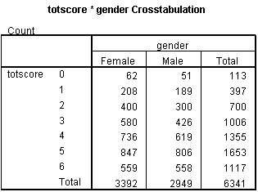
Picking a Criterion for Matching
Let’s look at these crosstabs for those people with same total score across the six items (example of an internal criterion).
Small sample sizes, might choose to collapse these rows. In this example I only consider the reponses with totscore = 1, 2, 3 and 4.
In this example the focal group is males (really should have chosen females, but doesn’t change the conclusions)

Slide 19
MH Notation
 |  | Score on Studied Item
 |  | 1 | 0 | Total
Group | Reference (R) | A_{j} | B_{j} | n_{Rj}
 | Focal (F) | C_{j} | D_{j} | n_{Fj}
 | Total | m_{1j} | m_{0j} | T_{j}
Where A, B, C, D represent #s of students in each cell, j = level of criterion
Estimated Probability member of R group gets item correct:
Estimated Probability member of R group gets item incorrect:
Estimated Probability member of F group gets item correct:
Estimated Probability member of F group gets item incorrect:

Slide 20
The MH Statistic
Estimated Probability member of R group gets item correct:
Estimated Probability member of R group gets item incorrect:
Estimated Probability member of F group gets item correct:
Estimated Probability member of F group gets item incorrect:
This is equivalent to Clauser & Mazor, p. 35

Slide 21
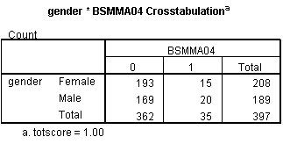
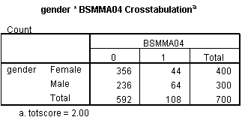
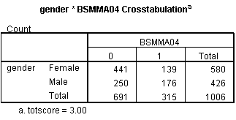
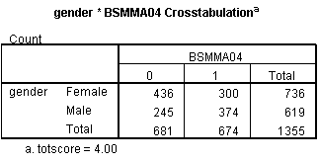
MH for TIMMS Item 4
Values > 1 indicate item was harder for focal group
Values < 1 indicate item was easier for focal group
So in this case item 4 is much easier for males

Slide 22
MH Odds and Ends
ETS Transformation to “delta” statistic:
Interpreted as the average amount more difficult that a member of the reference group (females) found the studied item relative to comparable members of focal group (males).
Negative numbers mean reference group found this item easy relative to focal group, positive numbers mean focal group found item easy relative to reference group
In the example
So even after the attempt to condition on ability, males found this item easier than females (females found it harder than males)
If DIF is found for one item, “purify” the total score criterion variable for remaining items.

Slide 23
ETS Rules of Thumb for Interpreting DIF
Level A: Statistically insignificant and delta < 1 in absolute value
Level B: Statistically significant OR between 1 and 1.5 in absolute value
Level C: Statistically significant & > 1.5 in absolute value
Level C items are almost never used in operational testing.
The example we just did would be an item with level C DIF. So here the observed impact (males do better than females) and evidence of DIF tell the same story. We should be concerned that this item is biased against females.

Slide 24
Example in R
The task is to compute MH statistics for the 31 items on the CDE math test to see if there is evidence of DIF by gender
Take out a piece of paper and jot down the steps you would need to take if you had to do this from scratch.
See the R Markdown file “Differential_Item_Functioning.html” for this worked example.

Slide 25
IRT Based Approaches to DIF

Slide 26
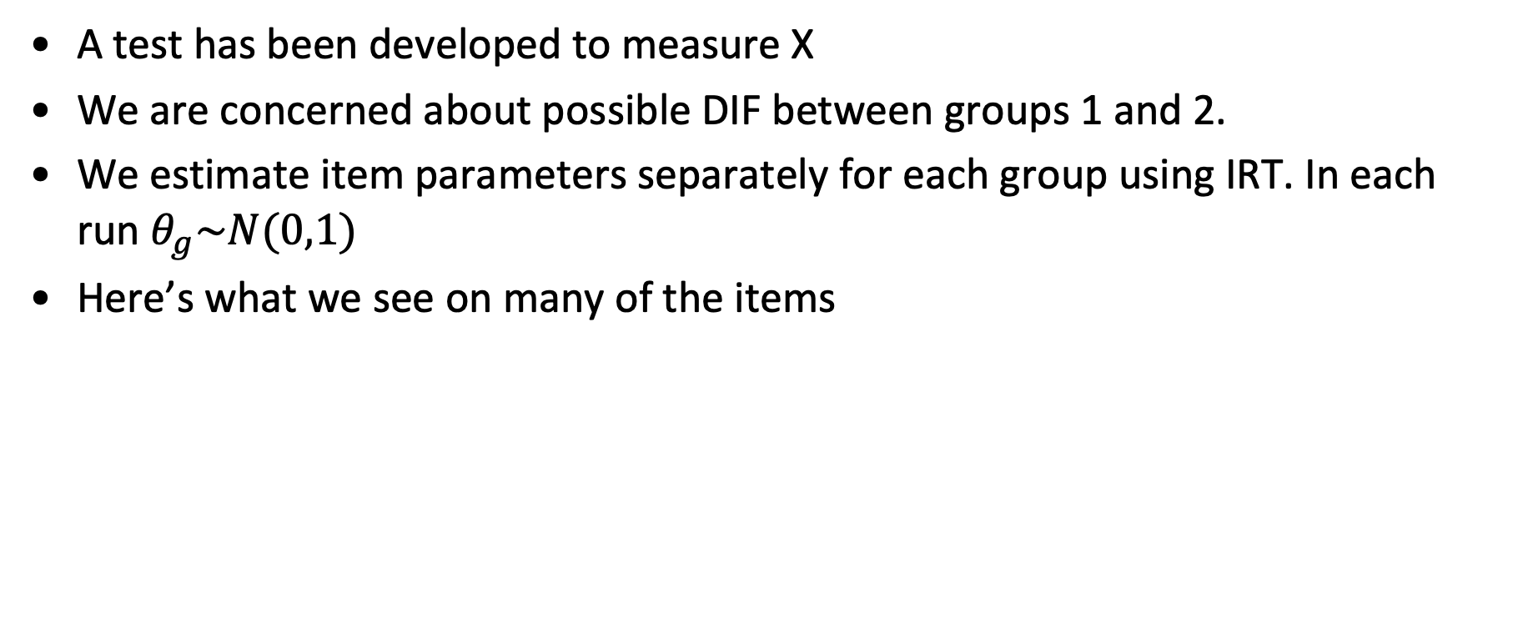
Hypothetical Scenario
A test has been developed to measure X
We are concerned about possible DIF between groups 1 and 2.
We estimate item parameters separately for each group using IRT. In each run $θ_{g}\sim N(0,1)$
Here’s what we see on many of the items
Differences between the ICCs by group that are both statistically and practically significant.
Is this evidence of DIF?

Slide 27
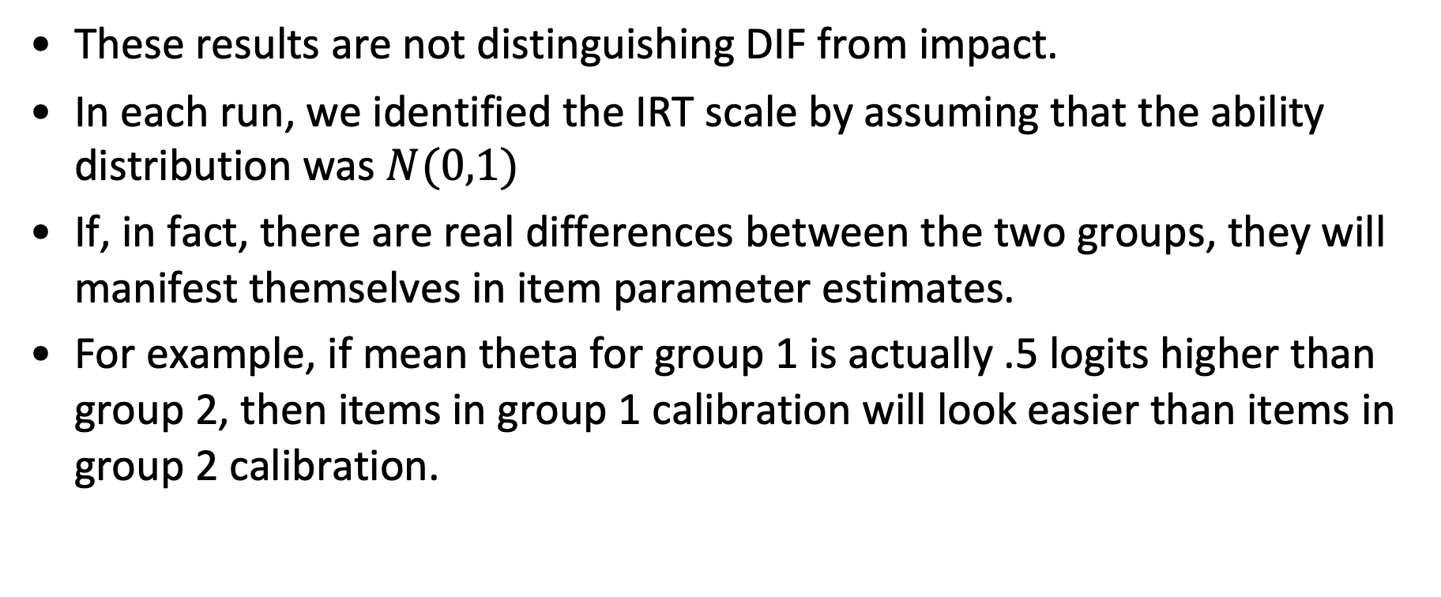
Problem
These results are not distinguishing DIF from impact.
In each run, we identified the IRT scale by assuming that the ability distribution was $N(0,1)$
If, in fact, there are real differences between the two groups, they will manifest themselves in item parameter estimates.
For example, if mean theta for group 1 is actually .5 logits higher than group 2, then items in group 1 calibration will look easier than items in group 2 calibration.

Slide 28
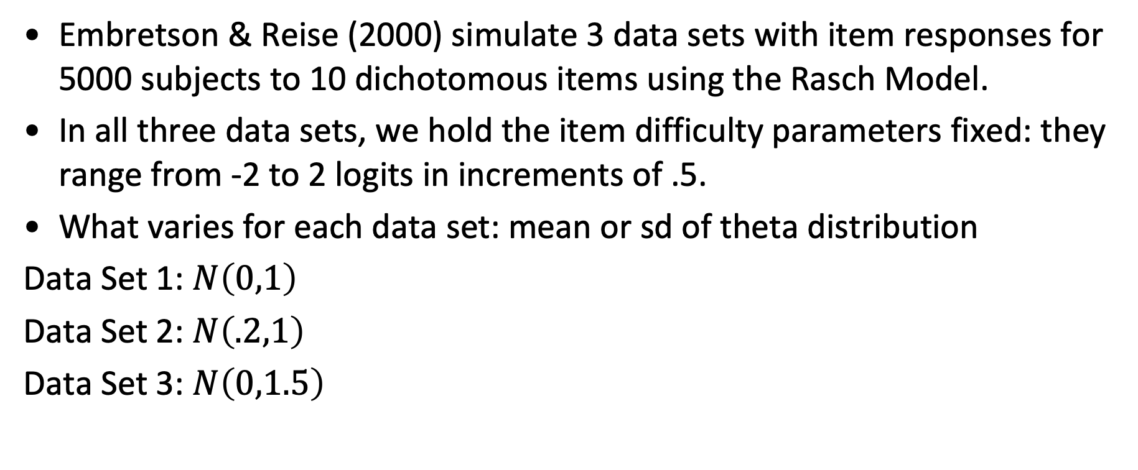
Illustration
Embretson & Reise (2000) simulate 3 data sets with item responses for 5000 subjects to 10 dichotomous items using the Rasch Model.
In all three data sets, we hold the item difficulty parameters fixed: they range from -2 to 2 logits in increments of .5.
What varies for each data set: mean or sd of theta distribution
Data Set 1: $N\left(0,1\right)$
Data Set 2: $N\left(.2,1\right)$
Data Set 3: $N\left(0,1.5\right)$

Slide 29
Results from Calibrating all Three Data Sets with 2PL
“A researcher would almost certainly conclude that the items contained DIF. However, the researcher would be absolutely wrong.” (E & R, 2000, 255)

Slide 30
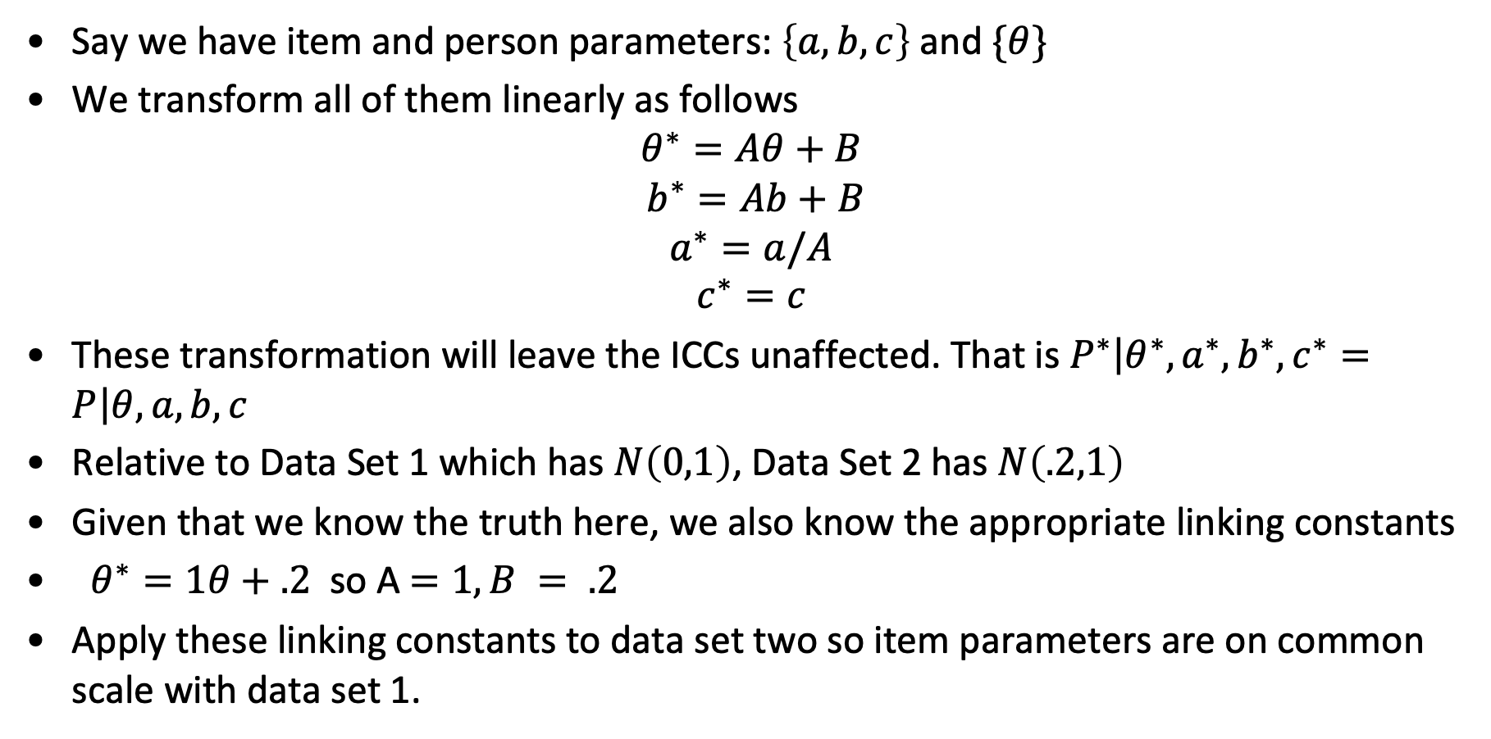
Linking Scales
Say we have item and person parameters: $\left\{a,b,c\right\}$ and $\{θ\}$
We transform all of them linearly as follows
$$θ^{∗}=Aθ+B$$
$$b^{∗}=Ab+B$$
$$a^{∗}=a/A$$
$$c^{∗}=c$$
These transformation will leave the ICCs unaffected. That is $P^{∗}\left|θ^{∗},a^{∗},b^{∗}, c^{∗}=P\right|θ,a,b,c$
Relative to Data Set 1 which has $N\left(0,1\right)$, Data Set 2 has $N\left(.2,1\right)$
Given that we know the truth here, we also know the appropriate linking constants
$θ^{∗}=1θ+.2$ so A$=1, B = .2$
Apply these linking constants to data set two so item parameters are on common scale with data set 1.
A and B are known as linking constants

Slide 31
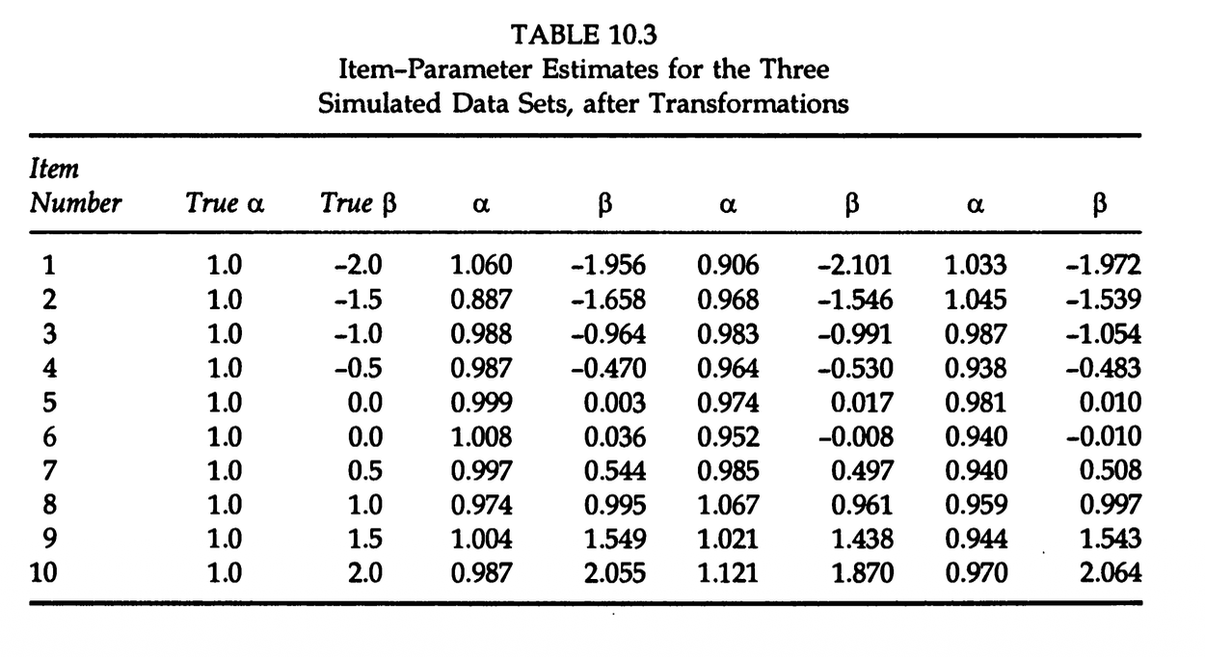
After Applying Linking Constants
We no longer see same evidence of DIF, even though estimates are not exactly the same due to estimation error

Slide 32
Estimating Linking Constants
We never know what the true differences in theta distributions are for each group
So how do we know what linking constants to use?
The typical strategy is to find a set of items that we think are DIF free
If they have no DIF, than any differences we observe in their ICCs must be caused by true differences in groups.
So we use this to generate estimates of linking constants.

Slide 33
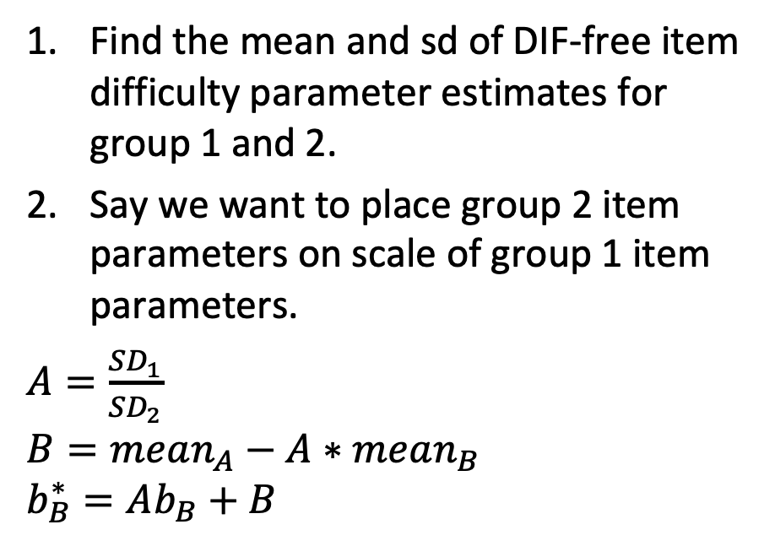
Two Common Approaches of Estimating Linking Constants
Mean-Sigma Method
Stocking-Lord Method
Find the mean and sd of DIF-free item difficulty parameter estimates for group 1 and 2.
Say we want to place group 2 item parameters on scale of group 1 item parameters.
$A=\frac{SD_{1}}{SD_{2}}$
$$B=mean_{A}−A∗mean_{B}$$
$$b_{B}^{∗}=Ab_{B}+B$$
Compute the TCC for all DIF-free items for groups 1 and 2.
Find the values of linking constants x and y that minimize the distance between the two TCCs.
This is generally considered a stronger method, but it is more complicated to implement without specialized code.

Slide 34
Visualization of Stocking-Lord Approach
For the TCCs
For given values of θ, take the difference between the response probabilities
Square the differences
Sum the squared differences across all theta values
Find the linking constants A and B that minimize these differences
To
From

Slide 35
Recap of Hypothetical Scenario
A test has been developed to measure X
We are concerned about possible DIF between groups 1 and 2.
We estimate item parameters separately for each group using IRT. In each run $θ_{g}\sim N(0,1)$
Here’s what we see on many of the items
There are two possible explanations:
Differences in the two group population distributions (obscurred by scale indeterminacy)
DIF
Before we can draw conclusions about 2, we need to account for 1. To do so the two scales need to be linked together.

Slide 36
How do we Identify DIF-free Items?
This is hard!
One approach might be to have those with content expertise and membership in focal group vouch for a subset of items.
A more objective approach (but not necessarily better) is to evaluate items for DIF iteratively.
Start by using theta associated with all items as matching criterion
Flag items that look like they have DIF
Now use a purified theta with suspected DIF items removed
Go back and examine items suspected of having DIF plus any new items that emerge.

Slide 37
The Logistic Ordinal Regression DIF Algorithm (lordif)

Slide 38
Steps of lordif
Data preparation and screening
IRT calibration
Trait (theta) estimation
Logistic regression
Detecting DIF
Split any item with suspected DIF into two items w/ missing data
IRT recalibration
Scale transformation (equating)
Trait (theta) reestimation using group-specific item parameters
Iterative Cycle
Monte Carlo simulation to evaluate statistical significance
Source: Choi, Gibbons & Crane (2011) in Journal of Statistical Software

Slide 39
1. Data Prep
Need a data file with rows = cases and columns that distinguish items and a salient grouping variable for respondents.
Check for sparse cells when grouping variable is crossed with items (i.e., < 5)
 | Person Cat 1 | Person Cat 2
Item 1 Category 1 | N_{a} | N_{c}
Item 1 Category 2 | N_{b} | N_{d}
In this example there are just two item categories and two groups of respondents—can be easily extended to multiple categories, but makes sparse cells more likely.

Slide 40
2. IRT Calibration
Use mirt to fit the Graded Response Model to the data, ignoring group distinctions among respondents.
i.e., out<-grm(data,1, itemtype="graded")
Note: GRM can be constrained to get something akin to Partial Credit Model, or equivalent to 2PL or 1PL. In eqn above j = item response category, i indexes item, and s indexes respondent. The “m” represents max score category, which need not be the same for every item, hence the the ”i” index.

Slide 41
3. Trait (Theta) Estimation
Obtain trait/ability/theta estimates using EAP approach.
Missing responses are treated as though item was not presented to person.
So in mirt, this could be done as follows:
eap<-fscores(out, method = "EAP", full.scores.SE = TRUE)

Slide 42
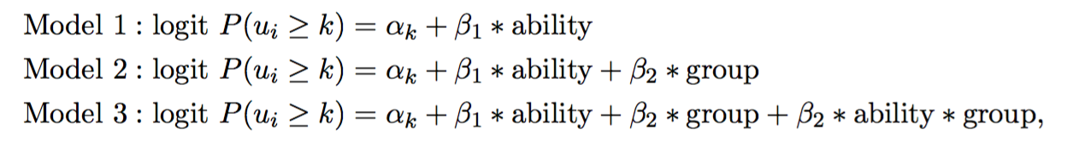
4. Logistic regression
We can compare model 2 to model 1 to see if there is evidence of uniform DIF—focus on size and significance of β₁
We can compare model 3 to model 2 to see if there is evidence of non-uniform DIF—focus on size and significance of β₂
We estimate three logistic regression models for each unique item!
Ability = theta estimated in previous step, group = dummy variable
Each model run generates a LR Chi-Square statistic and a pseudo R² statistic

Slide 43
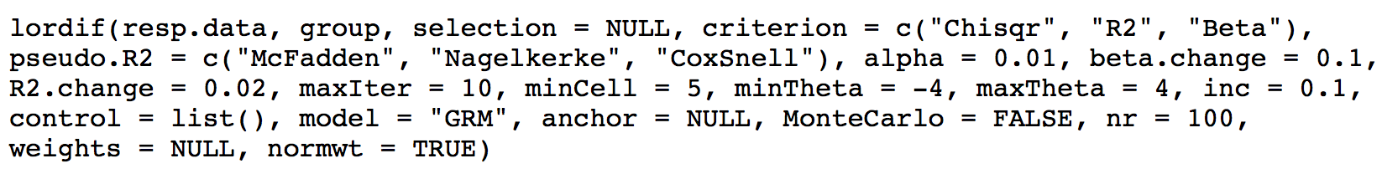
5. DIF Detection
Flag any item on basis of some decision criterion when comparing model 2 to 1 or model 3 to 2.
Typically done on basis of Chi-Square statistic with sig level (alpha) of .01.
But could also be done using pseudo R² or change in β₁ as criterion.

Slide 44
6. Split item with suspected DIF into two items w/ missing data
Person | Group | Item Response | New Item: Grp 1 | New Item: Grp 2
1 | 1 | 1 | 1
2 | 1 | 0 | 0
3 | 1 | 0 | 0
4 | 1 | 1 | 1
5 | 1 | 1 | 1
6 | 1 | 0 | 0
7 | 2 | 0 |  | 0
8 | 2 | 0 |  | 0
9 | 2 | 1 |  | 1
10 | 2 | 1 |  | 1
11 | 2 | 1 |  | 1
12 | 2 | 1 |  | 1

Slide 45
7. IRT Recalibration
Now recalibrate item parameters (using multigroup function in mirt) with group specific items
So if you had X items and subset Y was flagged for DIF, total number of items in new data set would be X+Y.

Slide 46
8. Scale Transformation (Equating)
Say we have 5 items flagged for DIF.
In step 7 of the lordif algorithm these 5 items get replaced by 10 pseudo items (5 per group). So this effectively doubles the item parameters that get estimated for these items.
How do we place these 10 pseudo items on a common scale?
Strategy: use the subset of non-DIF items as an anchor set.
For this anchor set parameter invariance should hold, so we should get same item parameter estimates whether calibrated using group 1 or group 2.
So calibrate anchor items separately for groups 1 and 2
Estimate linking constants using Stocking-Lord method (i.e., see slides 30-33)
Use these linking constants to place 5 pseudo items for focal group on the scale of the 5 items for reference group.

Slide 47
9. Trait (Theta) Re-estimation
Obtain new EAP trait (ability) estimates based on item parameter estimates from the entire sample for items that did not have DIF and for group-specific item parameter estimates for items that had DIF.

Slide 48
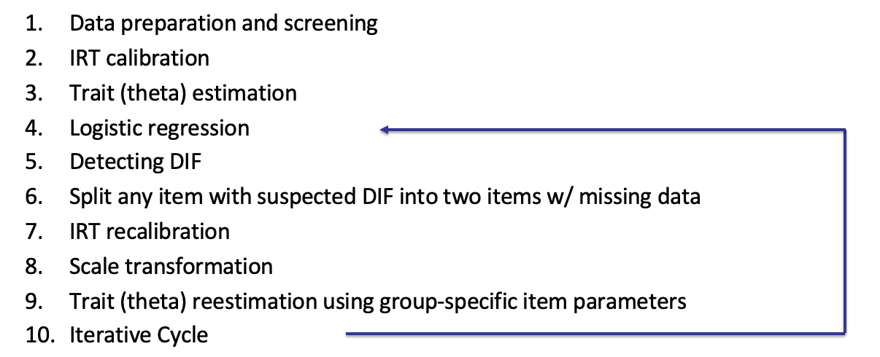
10. Iterative Cycle
Repeat Steps 4 through 9 until the same items are flagged for DIF or a preset maximum number of iterations has been reached.
Using the trait estimates from the previous round that account for DIF detected to that point, (ordinal) logistic regression DIF detection is repeated on all items including previously flagged items.

Slide 49
11. Monte Carlo Simulation
Generate DIF-free datasets “nr” number of times (e.g., nr = 1000), using the final trait estimates accounting for DIF (Step 10) and the initial single-group item parameter estimates (Step 2).
Each simulated dataset contains the same number of cases by group as the empirical dataset and reflects observed group differences (i.e., impact, not bias) in trait estimates.
For each simulated dataset, obtain trait (ability) estimates based on the single-group item parameter estimates and run the OLR/IRT procedure.
Establishes sampling distribution when null hypothesis of no DIF is true.
Compute the DIF statistics and magnitude measures for each simulated dataset and store the results for all replications.
Identify a threshold value for each statistic/magnitude measure that cuts off the most extreme (defined by α) end of its cumulative distribution.
Note: this takes a while to run. Took me 7 minutes as of 4/2024; took 40 minutes in 2014!

Slide 50
Illustration Using CDE Data
See file “Differential_Item_Functioning.html”
response<-cde[,1:31]
gender<-as.numeric(as.factor(cde[,32]))
DIF <- lordif(response, gender, criterion = "Chisqr", alpha = 0.01,minCell = 5)

Slide 51
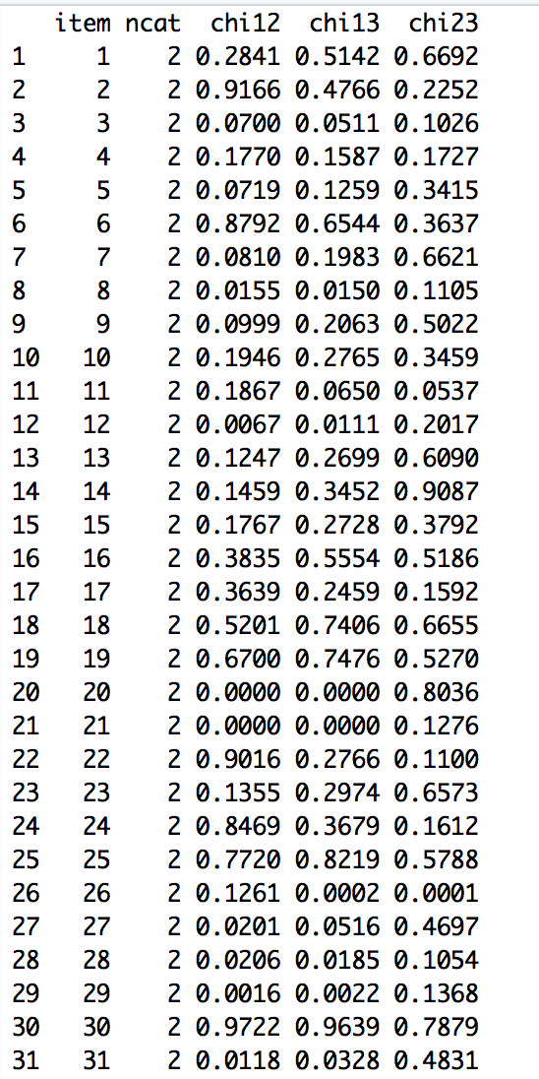
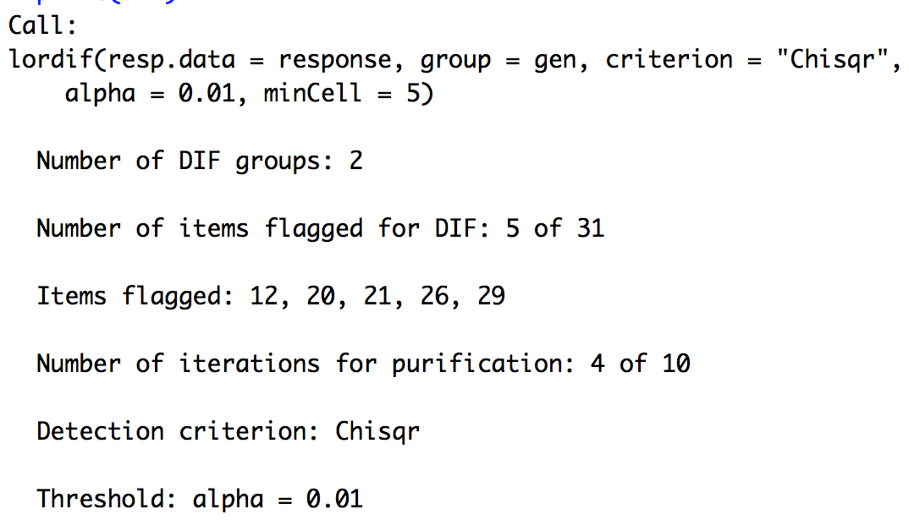
print(DIF)

Slide 52
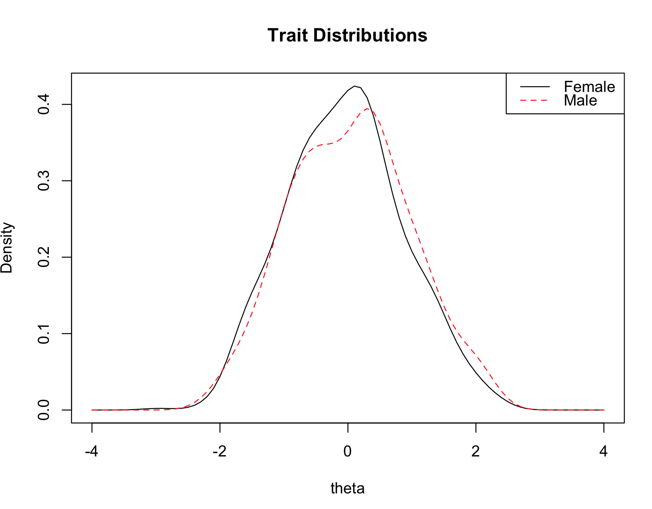
plot(DIF, labels = c("Female", "Male”))
This is the final estimate of the ”true” differences between the two groups on the underlying construct (based on items not flagged for DIF). We can see there is very little difference between these distributions, but males are slightly higher than females (note slight shift to the right of red line vs black).

Slide 53
Let’s have a closer look at the 5 items that were flagged for DIF

Slide 54
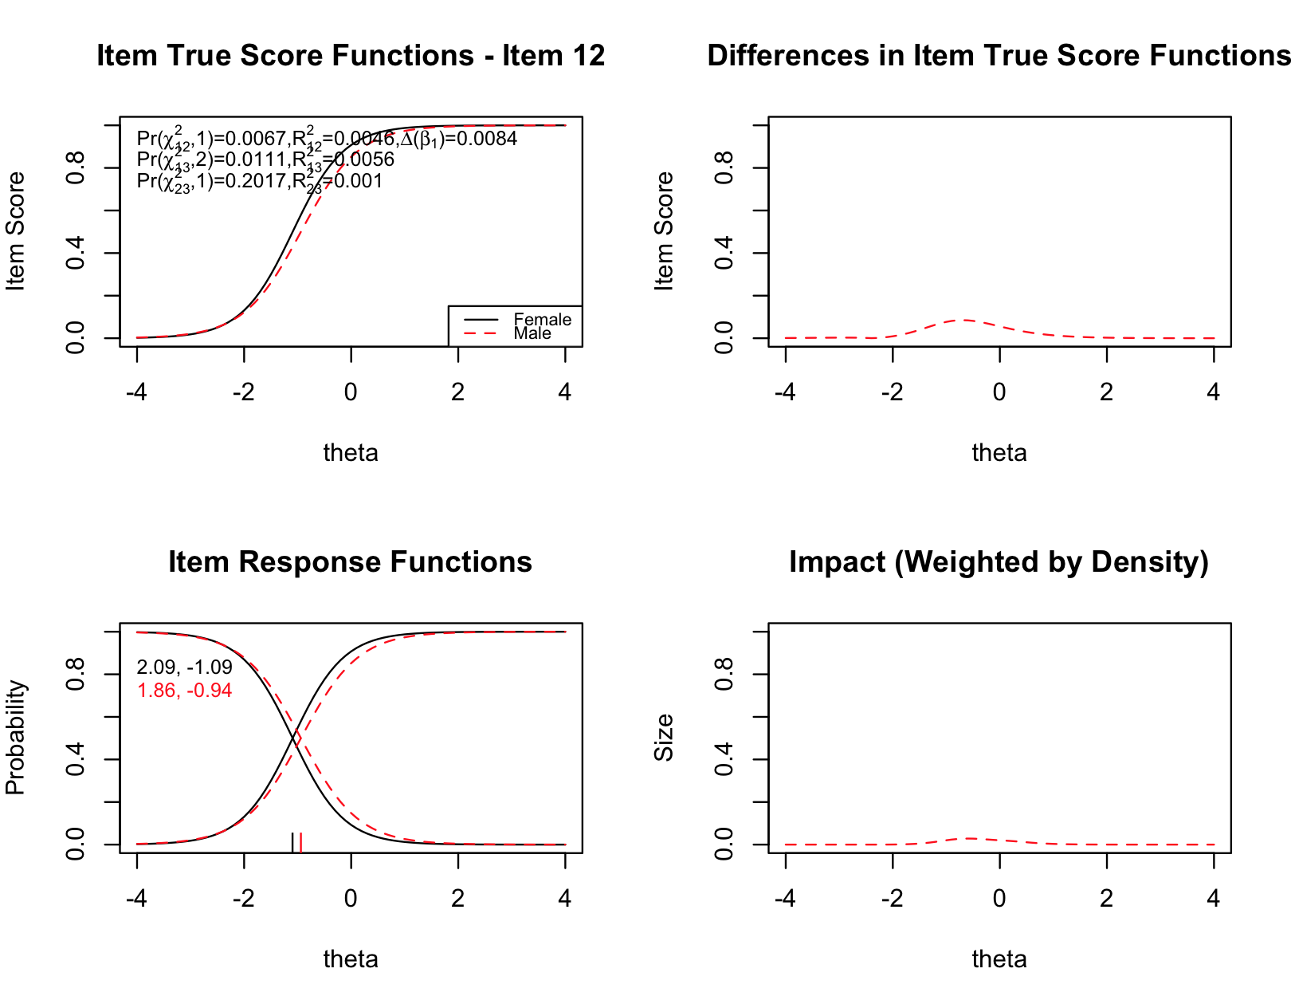
Note this item actually shows evidence of DIF in favor of females
Item location, females
Item slope, females
Notes:
Note this item actually shows evidence of DIF in favor of females

Slide 55
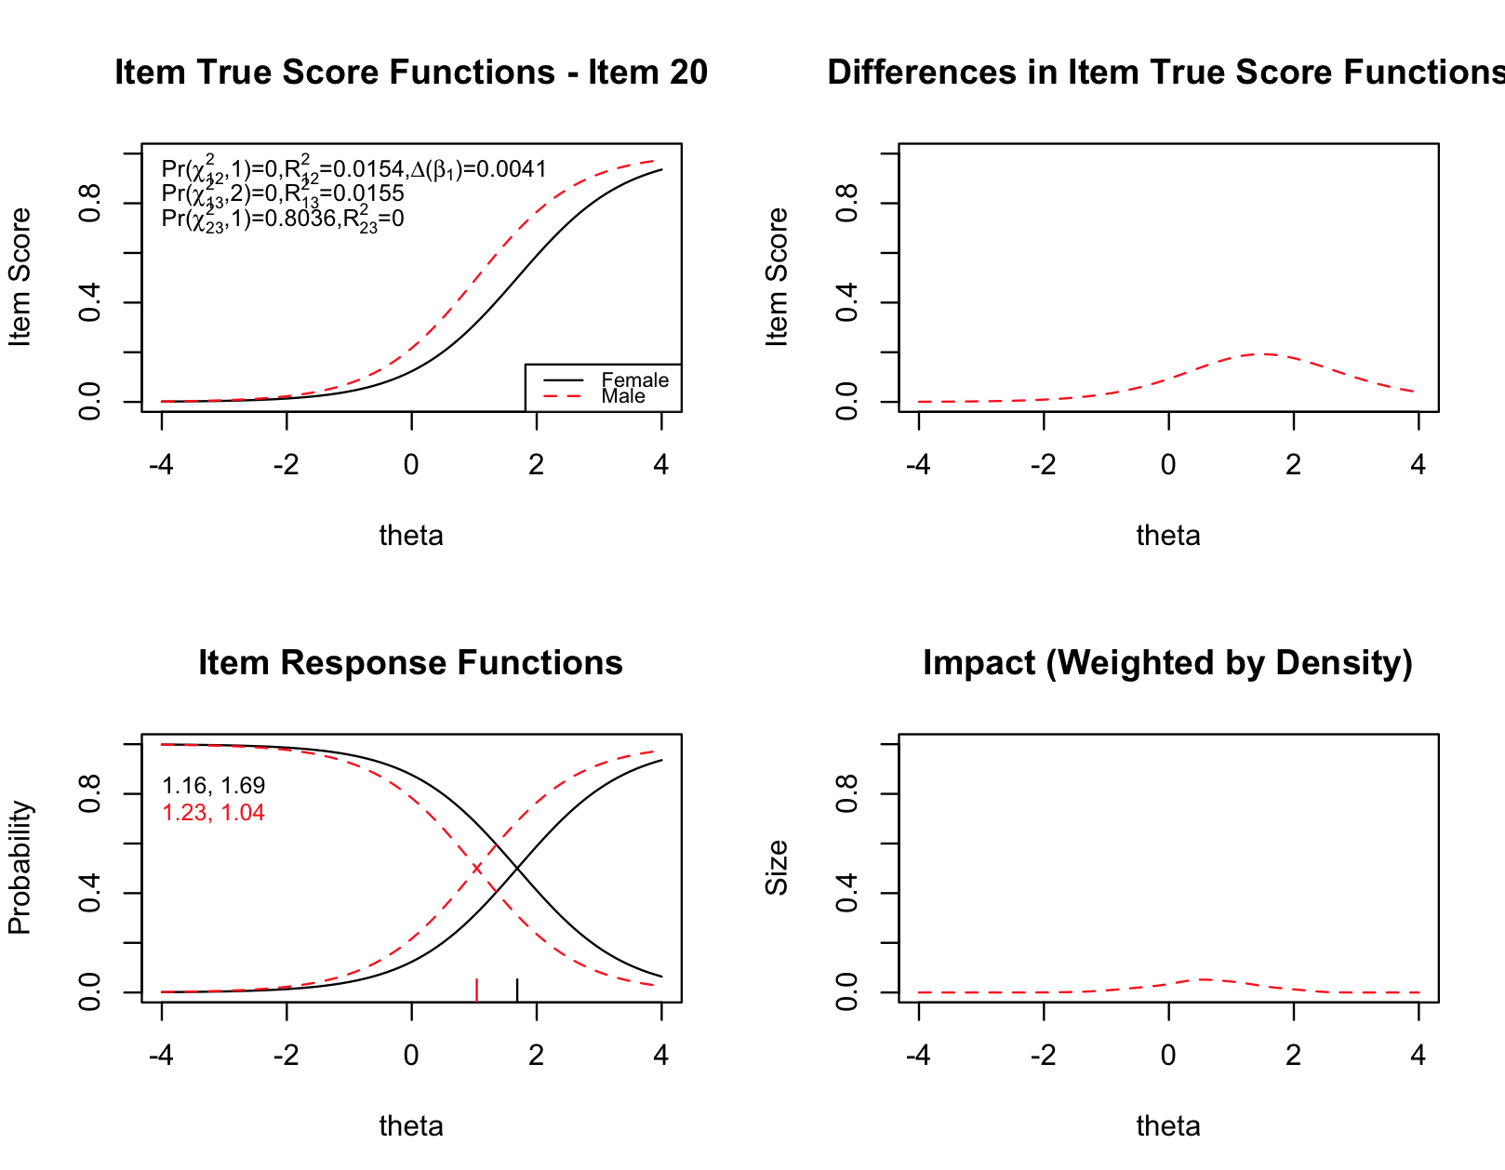

Slide 56
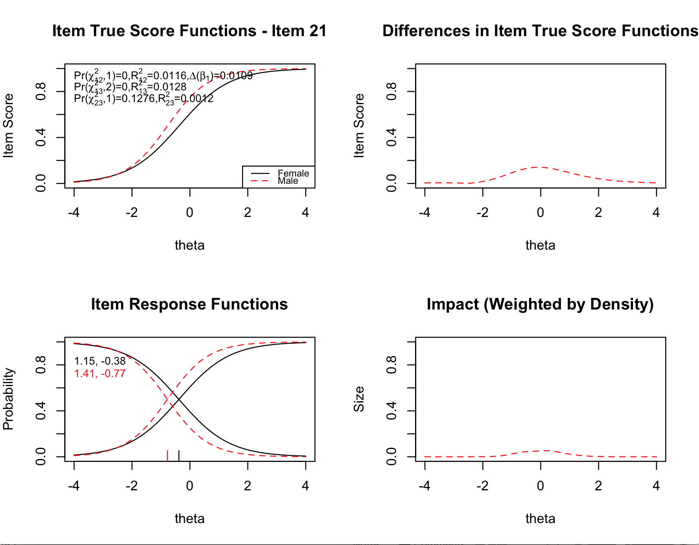

Slide 57
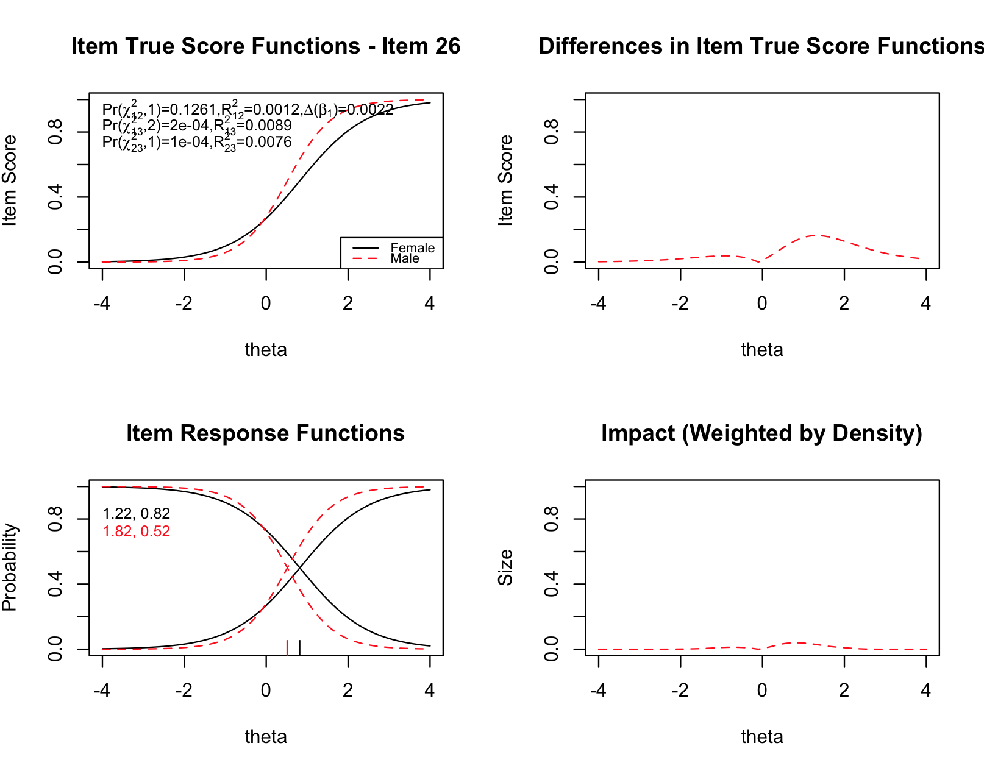
First example of strong non-uniform DIF
Notes:
First example of strong non-uniform DIF

Slide 58
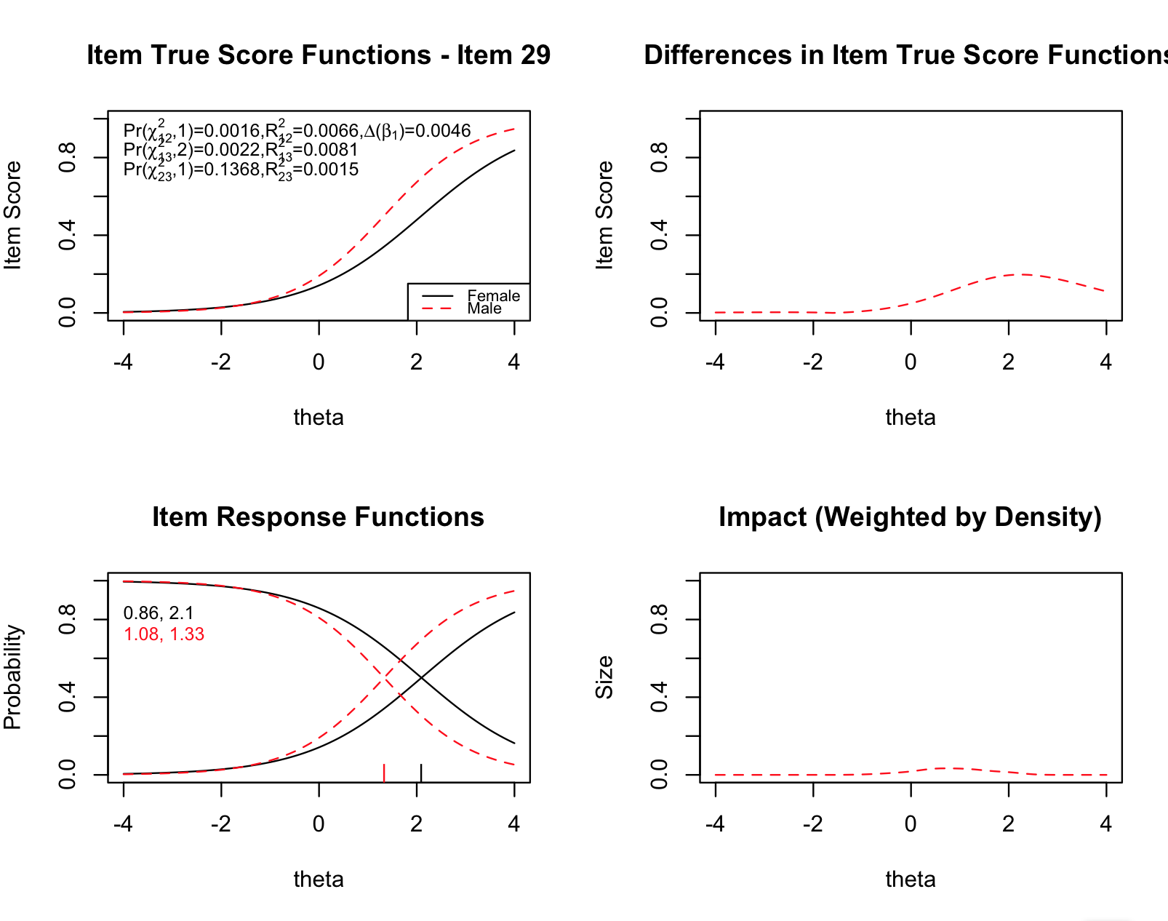

Slide 59
What’s the overall impact of DIF on test score inferences?

Slide 60
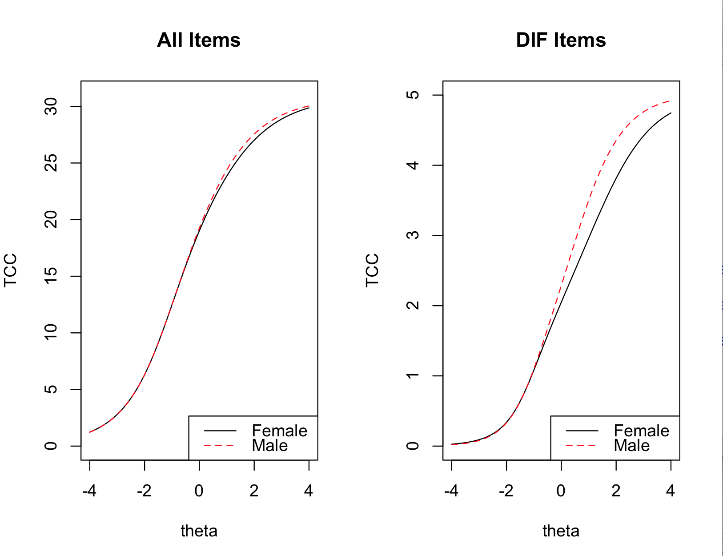

Slide 61
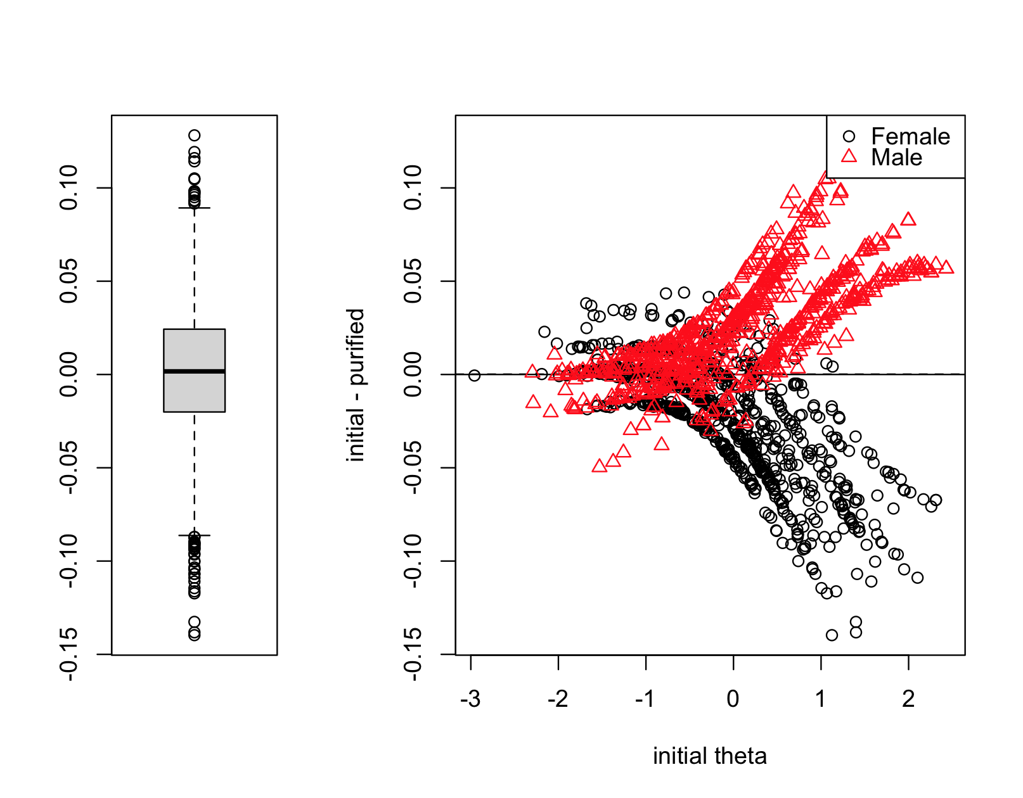
Impact on logit metric
Values > 0 indicate that after adjusting for DIF, score goes down (most males)
Values < 0 indicate that after adjusting for DIF, score goes up (most females)
But relative increase is very small.
Boxplot of all differences on right, ignoring initial theta

Slide 62
Are the Differences Practically Significant?
Recall that the SEM from 0 to 2 is between about .5 and .8 logits
The differences in individual thetas potentially caused by biased items is between .05 and .15 logits.
Impact seems rather small, but unlike measurement error, it is directional.
Gets added to females, subtracted from males

Slide 63
Comparing Results
MH | lordif
3 | 12
5 | 20
8 | 21
12 | 26
20 | 29
21
28
29
31
Items 20, 21 and 29 were flagged by both approaches.
MH flagged more as statistically significant, but only two of these would have been flagged based on ETS rules of thumb regarding practical significance.
We would want to have a closer look at the content of these items.

Slide 64
Homework Activity
You will be working in two groups. Each group will have a different data set.
Group 1: Use the files “DIF_Exercises1.R” and “DIF.data1.csv”
Group 2: Use the files “DIF_Exercises2.R” and “DIF.data2.csv”
Each data file has 2000 cases, 28 items, and a gender indicator. The item responses are simulated. Some items have DIF. Your task is to use the lordif approach to find them.

Slide 65
Summary
Important to keep three concepts distinct: impact, bias, DIF
Prominent non-IRT method of detecting DIF: MH
Flexible IRT method of detecting DIF: lordif
Detection depends on both statistical and practical significance
MH not well-equipped to detect non-uniform DIF
Almost all DIF methods use an internal matching criterion
Only some apply an iterative “purification” approach
Often difficult to explain the cause of DIF
DIF analyses are part of virtually all large-scale assessment programs

Slide 66
DIF References
Zwick, R. (2025) Fairness In Educational Measurement. In L. Cook & M. Pitoniak (eds) Educational Measurement, 5th Edition.
Choi, S., Gibbons, L. & Crane, P. (2011). lordif: An R Package for Detecting Differential Item Functioning Using Iterative Hybrid Ordinal Logistic Regression/Item Response Theory and Monte Carlo Simulations. Journal of Statistical Software. Vol 39(8).
Clauser, B. & Mazor, K. (1998) Using statistical procedures to identify differentially functioning test items. Educational Measurement: Issues and Practice. 17, 31-44.
Holland, P. & Thayer, D. (1988). Differential item performance and the Mantel-Haenszel procedure. In H. Wainer & H. Braun (Eds.) Test Validity (pp. 129-45). Hillsdale, NJ.
Penfield, R. & Lam, T. (2000) Assessing differential item functioning in performance assessment: review and recommendations. Educational Measurement: Issues and Practice, 19, Fall 5-15.

